Slide 2
CNET Team, Intelligent Systems Research Centre, School of Computing, Engineering & Intelligent Systems, Ulster University, Magee Campus, Derry, Northern Ireland
Ionostasis at the Tripartite Synapse: Computational Modelling of Neuron-Glia Interactions
Marinus Toman

Slide 3
Introduction
Tripartite Synapse
Astrocyte Channels
Astrocyte Model Tutorial
Astrocyte Modelling
Microglia Modelling
Astrocytes Neurons
Dev & Use of Models
Neuronal AP Model
Neuron Model Tutorial
Neuron-Astroglial Interaction Model

Slide 4
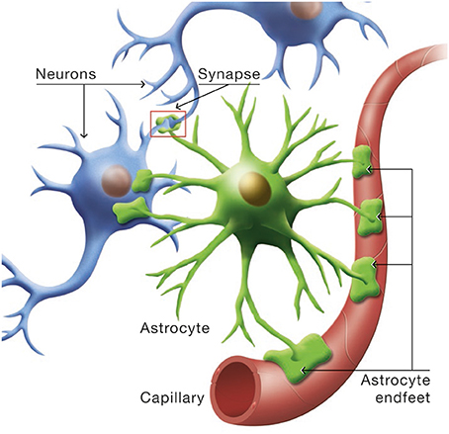
Background
Neurons
Carry brain’s electrical signals
Astrocytes
Support cells - various roles
Microglia
Brain’s immune system
Neuro-Astro Interactions
Synapse
Astrocyte signalling

Slide 5
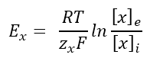
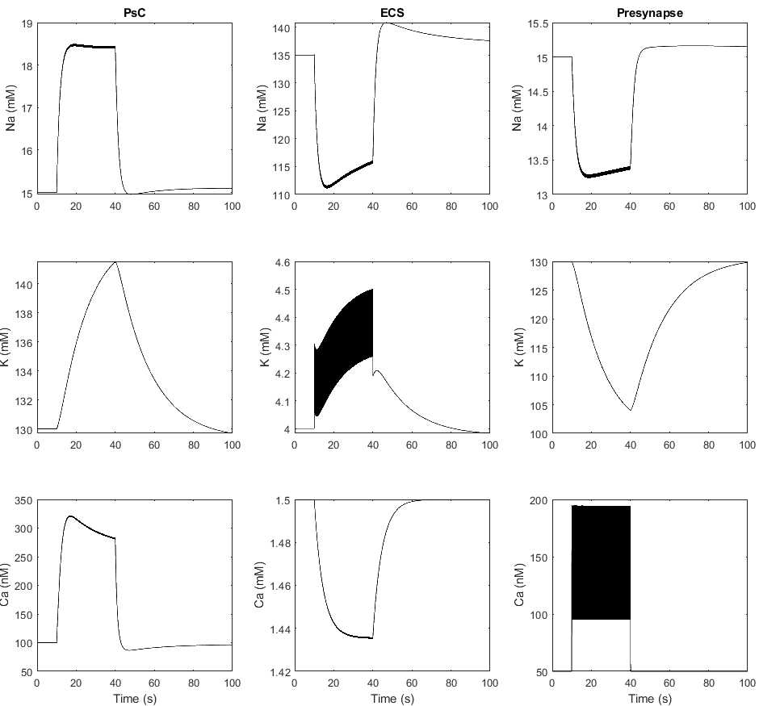
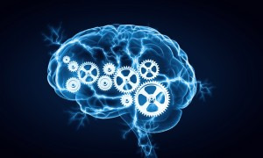
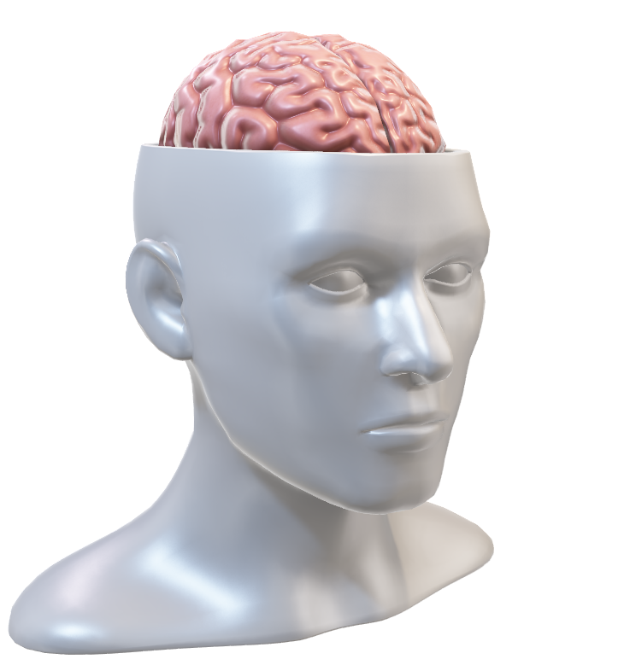
Development and Use of Model
Math
Code
Create model
Validate
Analyse
Predict
Experiments
Test
Compare
Edit

Slide 6
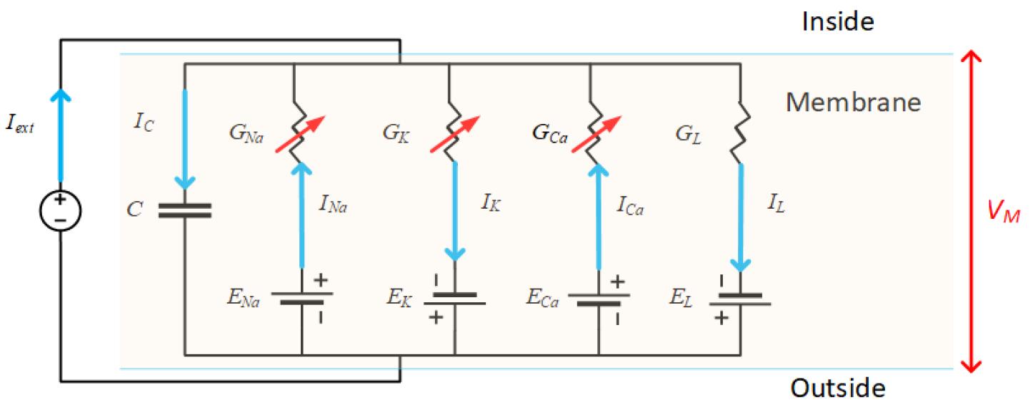
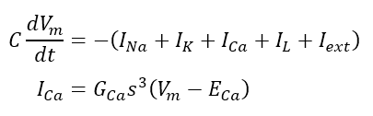
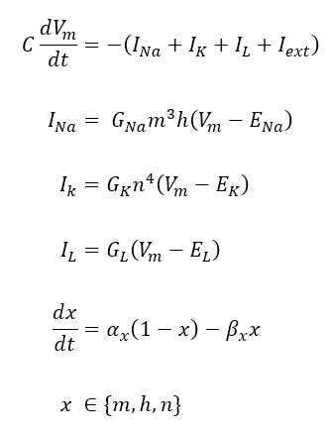
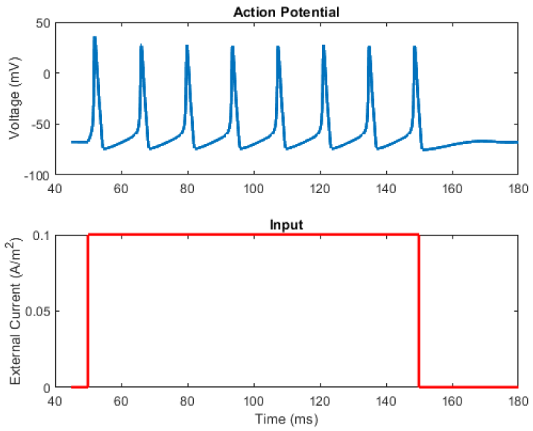
Neuron Action Potential Model
Changing Membrane Potential
Ion Channel Currents
Ion Channel Gating Kinetics
Reference: A. L. Hodgkin and A. F. Huxley, “A quantitative description of membrane current and its application to conduction and excitation in nerve.,” J. Physiol., vol. 117, no. 4, pp. 500–44, Aug. 1952, doi: 10.1007/BF02459568.

Slide 7
Demonstration
Hodgkin-Huxley Neuron Action Potential Model:
Solving HH model with the MATLAB ODE solver

Slide 8
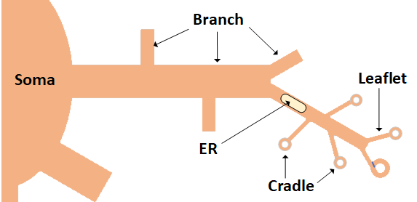
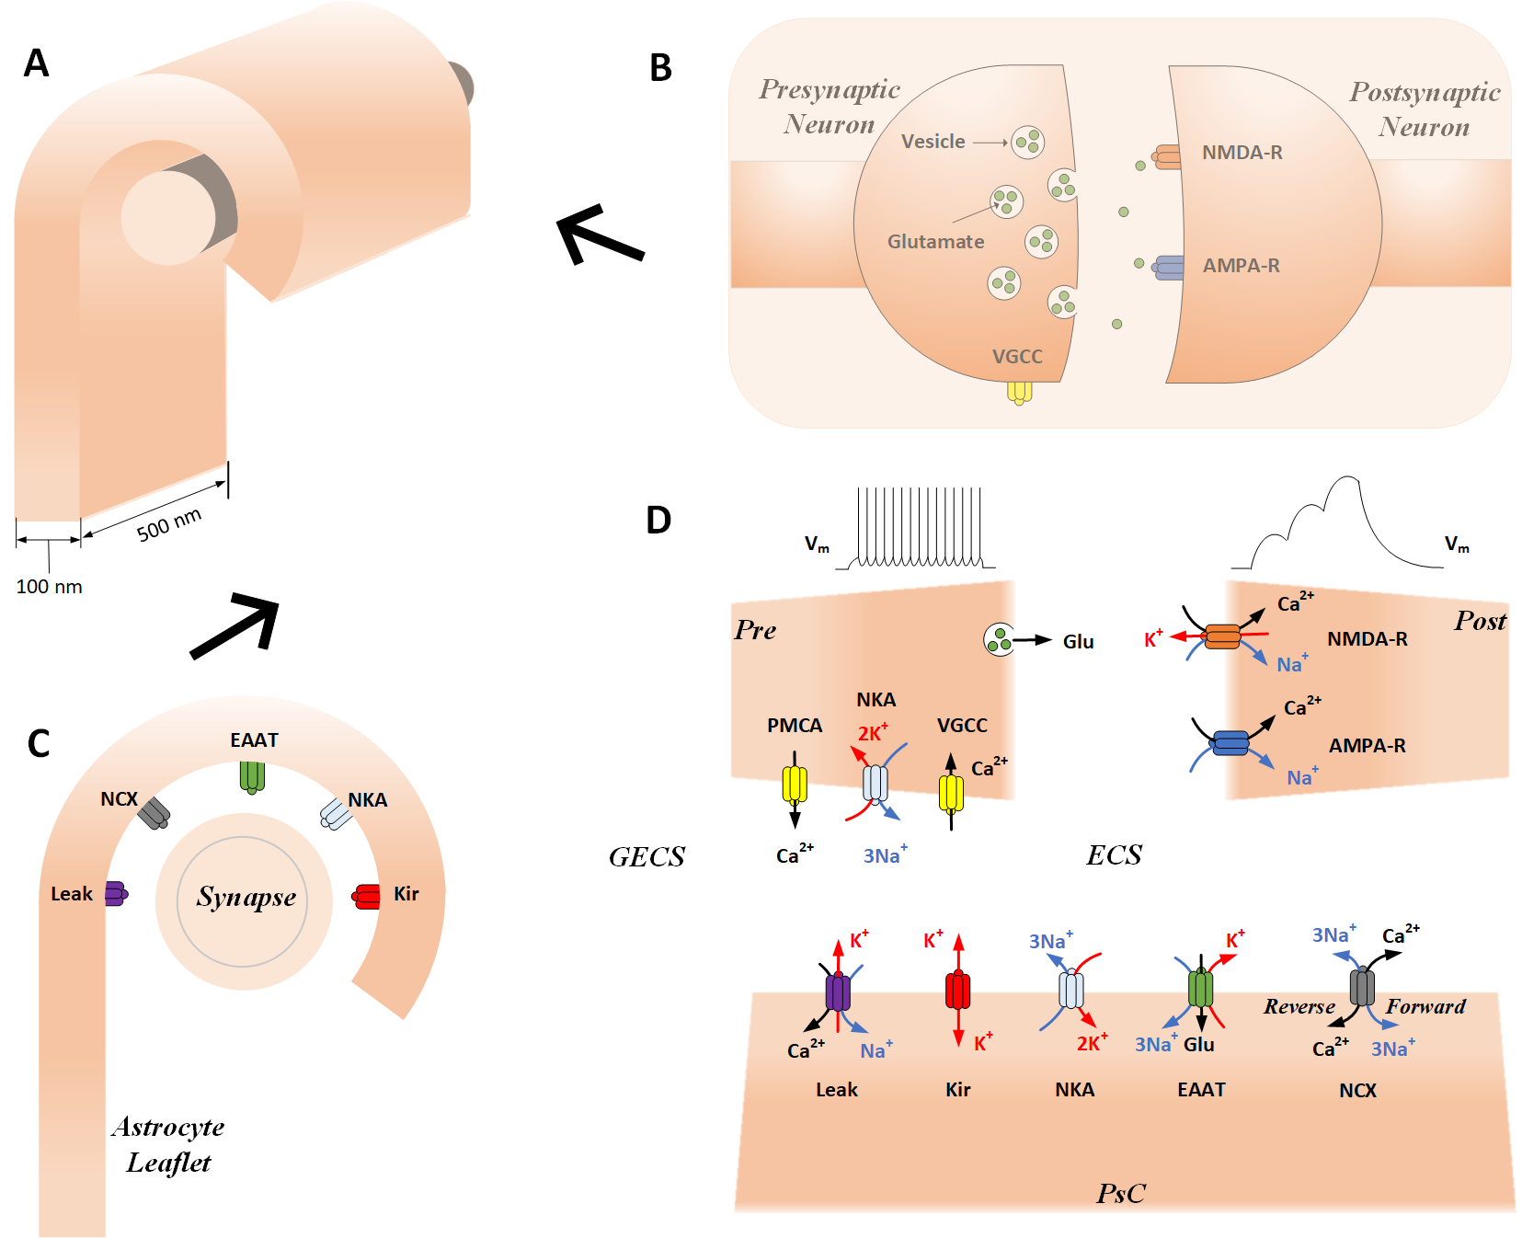
Astrocyte Modelling
Cradle
Different levels of models
astrocyte networks
single cells
sub-cellular
Cradle
Same modelling techniques as neurons
channels/transporters in a membrane
astrocytes typically have different channels than neurons
Synapse
Leaflet

Slide 9
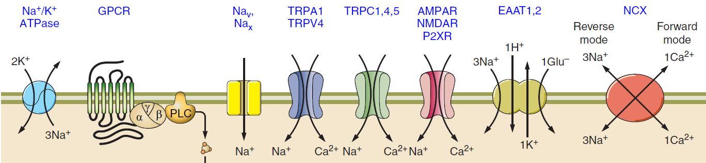
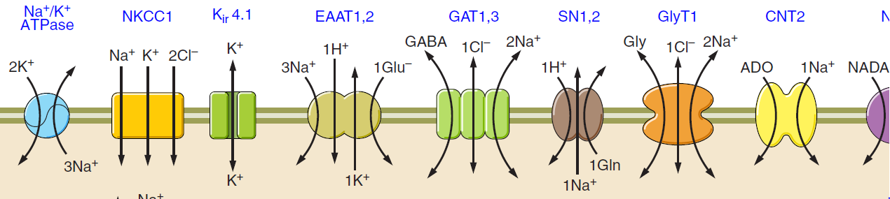
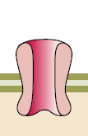
Receptors / Channels
VGCC
Ca²⁺
Reference: Verkhratsky A, Nedergaard M. Physiology of Astroglia. Physiol Rev 98: 239–389, 2018. doi:10.1152/physrev.00042.2016.

Slide 10
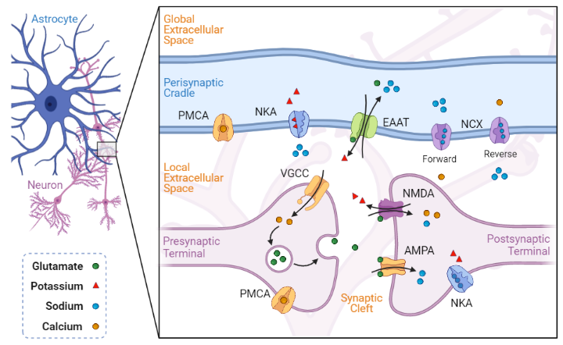
Ionostasis at the Tripartite Synapse

Slide 11
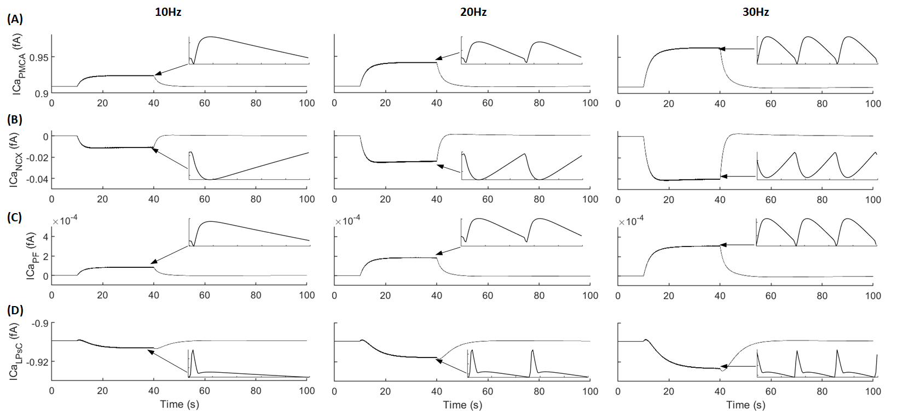
Ionostasis at the Tripartite Synapse
Reference: Toman M, Wade JJ, McDaid L & Harkin J (2020). Computational Study of Astroglial Calcium Homeostasis in a Semi-isolated Synaptic Cleft. In 2020 International Joint Conference on Neural Networks (IJCNN), pp. 1–8. IEEE.

Slide 12
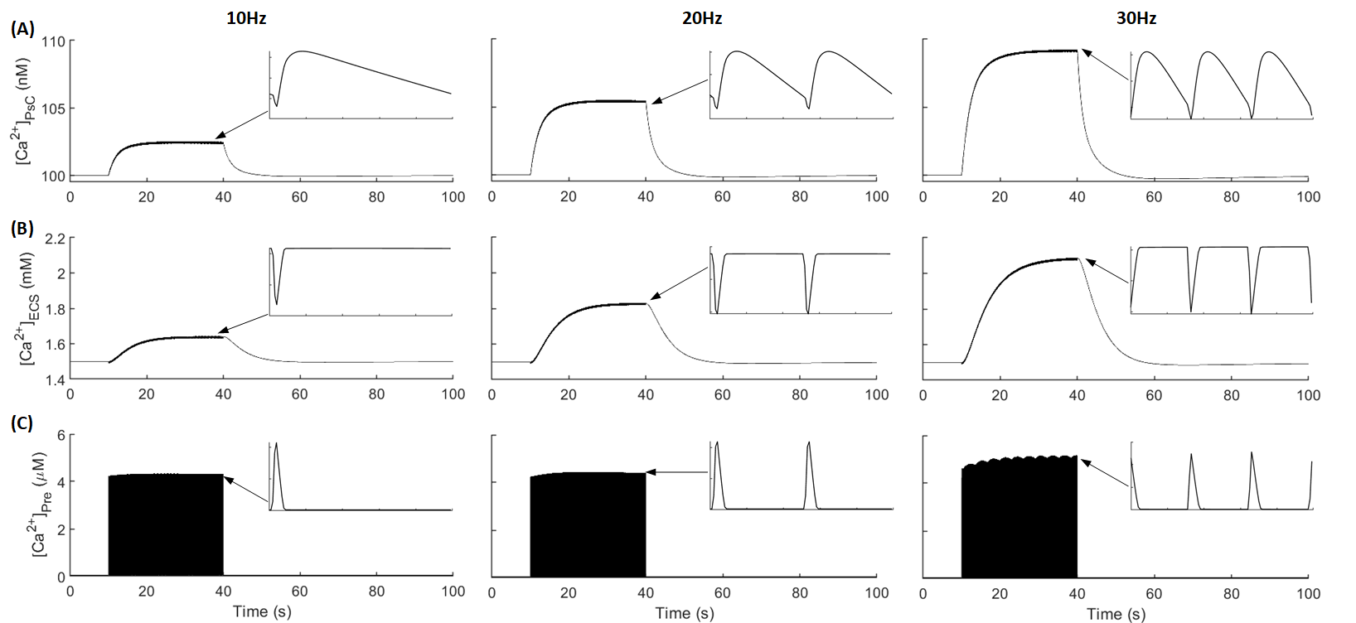
Ionostasis at the Tripartite Synapse
Reference: Toman M, Wade JJ, McDaid L & Harkin J (2020). Computational Study of Astroglial Calcium Homeostasis in a Semi-isolated Synaptic Cleft. In 2020 International Joint Conference on Neural Networks (IJCNN), pp. 1–8. IEEE.

Slide 13
Ionostasis at the Tripartite Synapse
Reference: Toman M, Wade JJ, McDaid L & Harkin J (2020). Computational Study of Astroglial Calcium Homeostasis in a Semi-isolated Synaptic Cleft. In 2020 International Joint Conference on Neural Networks (IJCNN), pp. 1–8. IEEE.

Slide 14
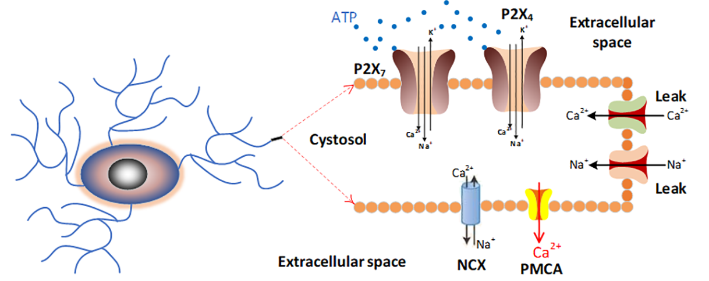
Microglia Modelling
Reference: Poshtkohi A, Wade J, McDaid L, Liu J, Dallas M & Bithell A (2021). Mathematical modelling of human P2X-mediated plasma membrane electrophysiology and calcium dynamics in microglia ed. Weinstein H. PLOS Comput Biol.

Slide 15
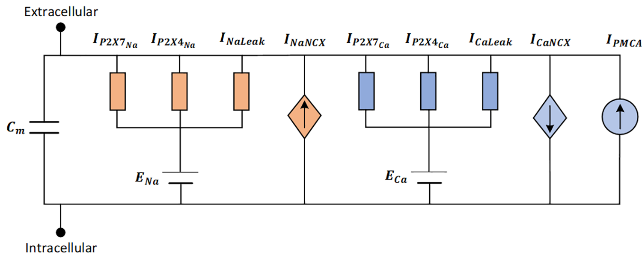
Microglia Modelling
Reference: Poshtkohi A, Wade J, McDaid L, Liu J, Dallas M & Bithell A (2021). Mathematical modelling of human P2X-mediated plasma membrane electrophysiology and calcium dynamics in microglia ed. Weinstein H. PLOS Comput Biol.

Slide 16
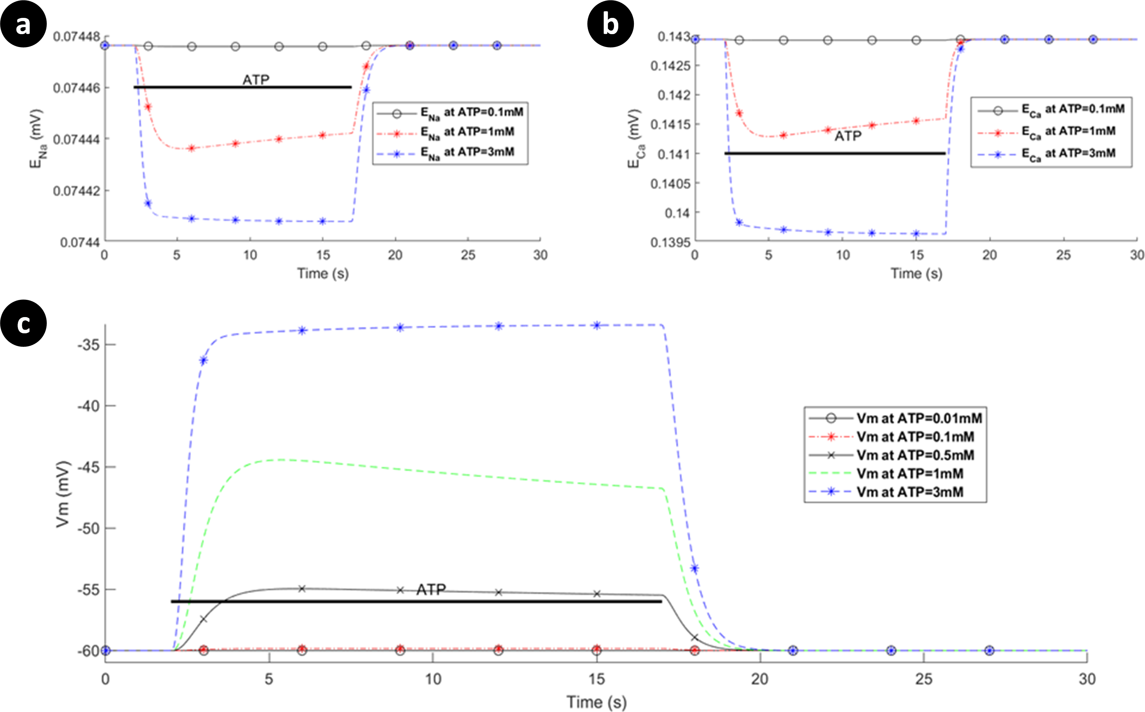
Microglia Modelling
Reference: Poshtkohi A, Wade J, McDaid L, Liu J, Dallas M & Bithell A (2021). Mathematical modelling of human P2X-mediated plasma membrane electrophysiology and calcium dynamics in microglia ed. Weinstein H. PLOS Comput Biol.

Slide 17
Microglia Modelling
Reference: Poshtkohi A, Wade J, McDaid L, Liu J, Dallas M & Bithell A (2021). Mathematical modelling of human P2X-mediated plasma membrane electrophysiology and calcium dynamics in microglia ed. Weinstein H. PLOS Comput Biol.

Slide 18
Demonstration
Astrocyte Homeostasis Model:
Solving model with Euler’s method

Slide 19
Conclusion
Tripartite Synapse
Astrocyte Channels
Astrocyte Model Tutorial
Astrocyte Modelling
Microglia Modelling
Astrocytes Neurons
Dev & Use of Models
Neuronal AP Model
Neuron Model Tutorial
Model Parameter Exploration
Neuron-Astroglial Interaction Model

Slide 20
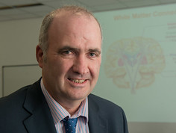

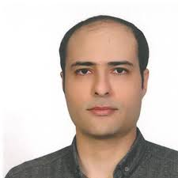

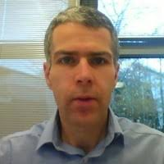
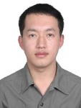
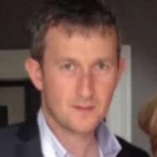
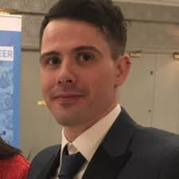

Computational Neuroscience and Neuromorphic Engineering Team (CNET)
Prof. L. McDaid Dr. J. Wade Dr. B. Flanagan A. Poshtkohi
Prof. J. Harkin Dr. J. Liu M. McElholm Dr. G. Martin A. Javed

